Slide 1
Agentic AI Health Symptom Checker
IBM AICTE PROJECT
Presented By:
Student name :Kavya B A
College Name & Department :Dayananda Sagar Academy Of Technology and Management [Information Science and Engineering]

Slide 2
OUTLINE
Problem Statement
Technology used
Wow factor
End users
Result
Conclusion
Future scope
IBM Certifications
Git-hub Link

Slide 3
Problem Statement
People often face difficulty in understanding their health symptoms and deciding when to seek medical care. Manual self-diagnosis through online searches can be misleading, unverified, and dangerous, often resulting in anxiety or delayed treatment.
Proposed Solution: An AI agent that accepts symptoms in natural language, refers to verified sources like WHO and government health portals, and returns:
Possible causes
Urgency level
Home remedies
When to consult a doctor Supports multilingual input and avoids giving medical diagnoses.

Slide 4
Technology used
IBM cloud lite services
Natural Language Processing (NLP)
IBM Granite model

Slide 5
IBM cloud services used
IBM Cloud Watsonx AI Studio
IBM Cloud Watsonx AI runtime
IBM Cloud Agent Lab
IBM Granite foundation model

Slide 6
Wow factors
Accepts symptoms in natural language
Provides safe, educational, non-diagnostic advice
Pulls information only from verified health sources
Multilingual input support (e.g., Kannada, Hindi)
Real-time suggestion of urgency and doctor referral guidance
Supports early detection and reduces misinformation

Slide 7
End users
General public
Rural and urban health seekers
Digital health platforms
Telemedicine services
Government or NGO health outreach teams

Slide 8
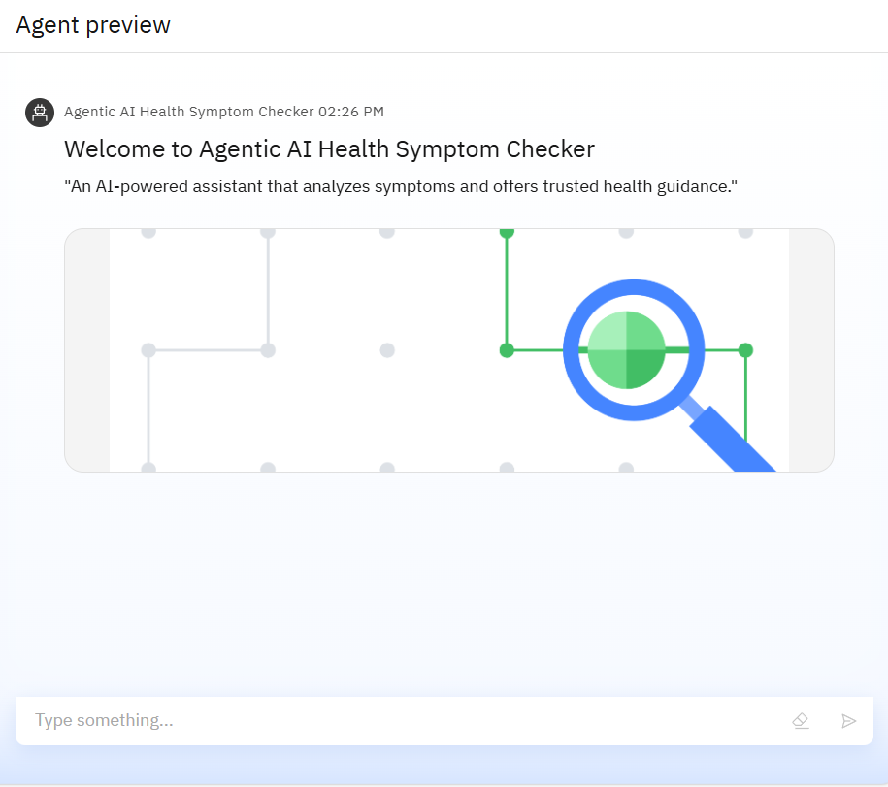
Results
Agent Preview Interface of the Agentic AI Health Symptom Checker. The AI assistant welcomes users and is ready to accept natural language symptom input to provide educational health guidance.

Slide 9
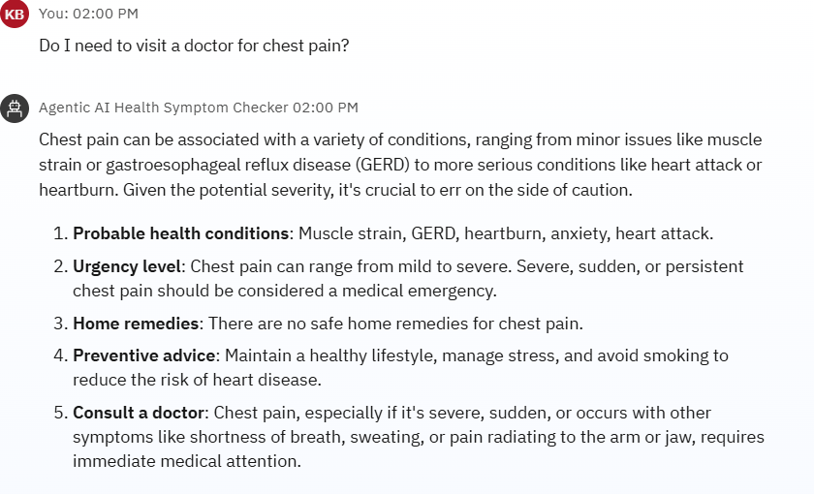
Results

Slide 10
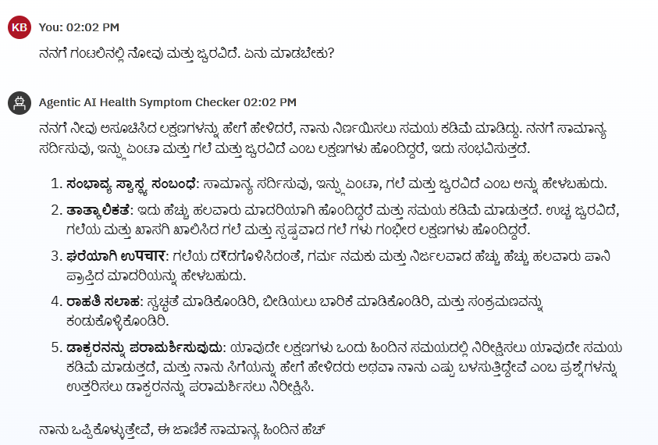
Results
Demonstrating Multilingual Support: The AI Health Symptom Checker successfully accepts and interprets user queries in Kannada, showcasing its ability to support regional languages for wider accessibility.

Slide 11
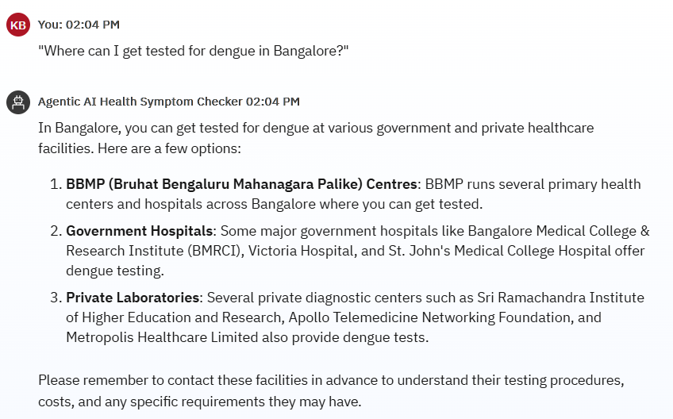
Results

Slide 12
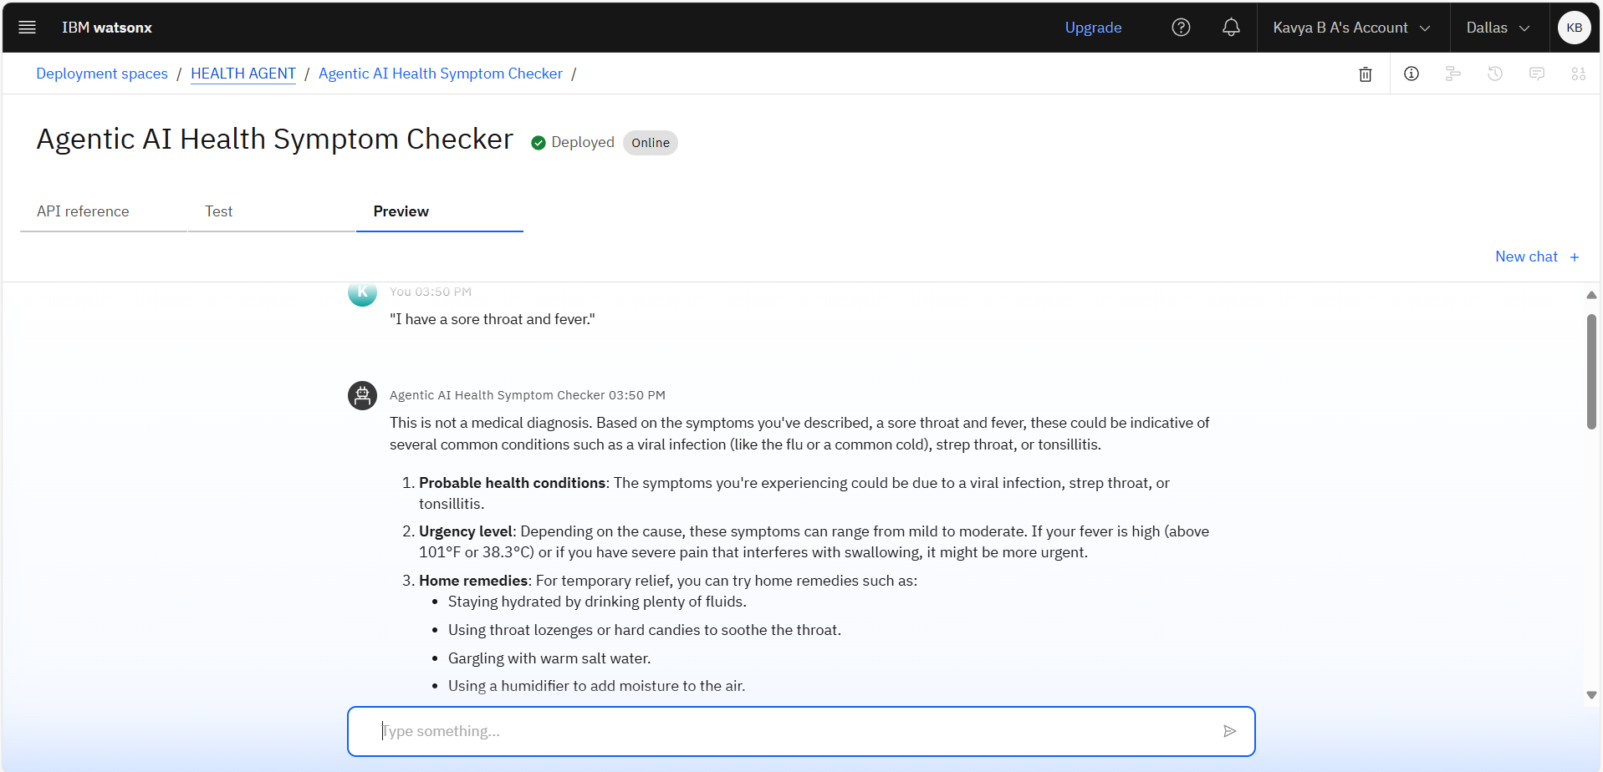
Results
Deployed AI Agent

Slide 13
Conclusion
The Agentic AI Health Symptom Checker demonstrates how large language models can be used responsibly to support health awareness and guidance.
By analyzing symptoms described in natural language and referring to verified medical sources like WHO and government health portals, the AI agent helps users make informed decisions while avoiding self-diagnosis risks.
The project showcases the power of IBM Watsonx Granite, NLP, and cloud deployment in building intelligent, multilingual, and accessible AI solutions for public well-being.

Slide 14
Future scope
Voice-based symptom input
Automatic region-based health recommendations
Expansion to include maternal & child health, mental health
Emergency alert system for high-risk symptoms
Integration with hospital systems or telemedicine portals

Slide 15
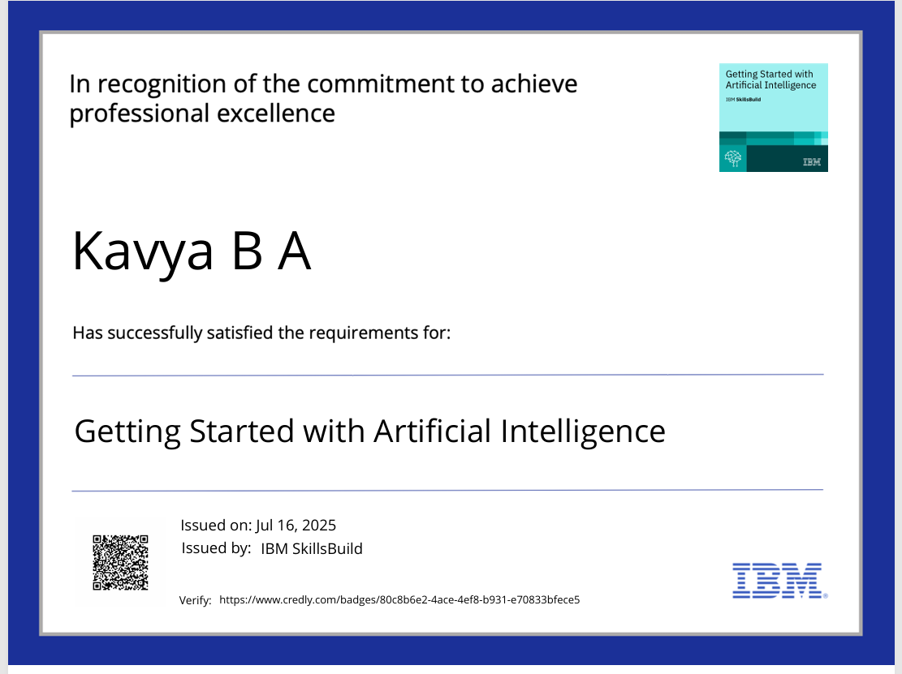
IBM Certifications

Slide 16

IBM Certifications

Slide 17
GITHUB LINK
https://github.com/Kavyaba2004/Health-Agent

Slide 18
THANK YOU

